Slide 1

TESSERACT: TExt-Supervised SEgmentationfor RAdiology with Cross-attentional Transformers
Name: Swakshar Deb (swd9tc), Rishov Paul (vst2hb)
Date: 05/09/2025

Slide 2
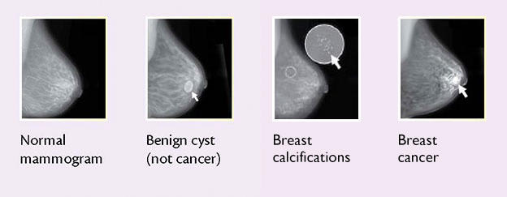
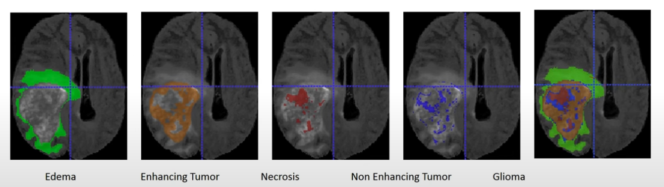
Motivation
Segment Anything V2 relies on bounding boxes, keypoints, or masks for segmentation.
Difficult to accurately identify initial masks
Traditional segmentation Model in computer vision is only suited for rigid body segmentation
Notes:
The motivation of this project

Slide 3
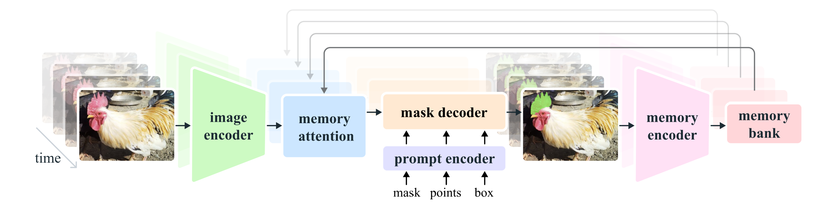
Background
.
SAM v2 is designed for both static and temporal images (i.e., videos)
.
SAM v2 does not support text conditioning

Slide 4
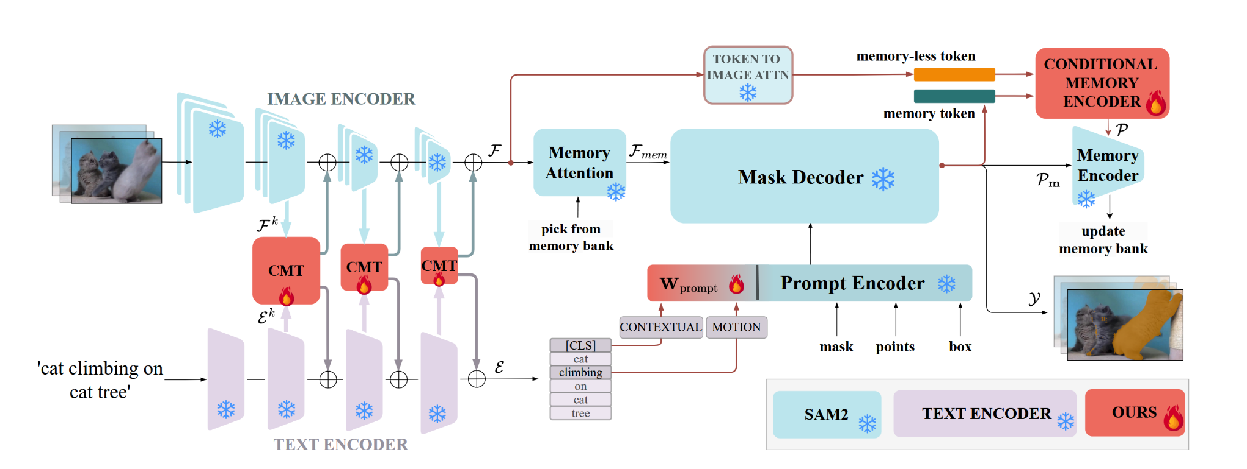
Related Work
.
SAMWISE^{[1]} can provide segmentation based on text instruction for video streaming like scenarios.
^{[1]}Cuttano et al., SAMWISE: Infusing Wisdom in SAM2 for Text-Driven Video Segmentation, CVPR 2025

Slide 5
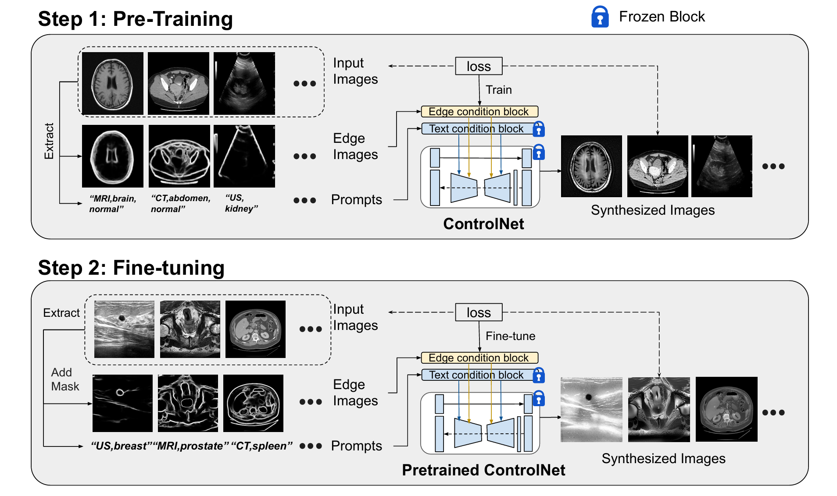
Related Work
Diffusion based medical image segmentation

Slide 6
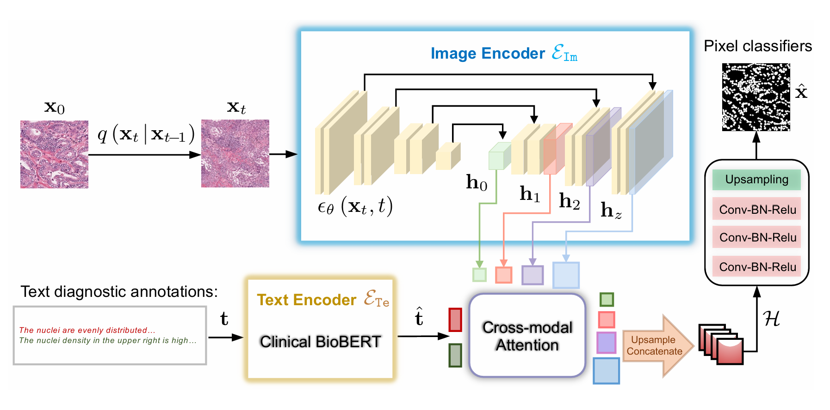
Related Work
Diffusion based medical image segmentation

Slide 7
An Intuitive Figure Showing WHY Claim
Diffusion based segmentation is not suitable for real-world segmentation
High inference time for segmentation due to progressive denoising
Notes:
Here, we make the claim of this project.

Slide 8
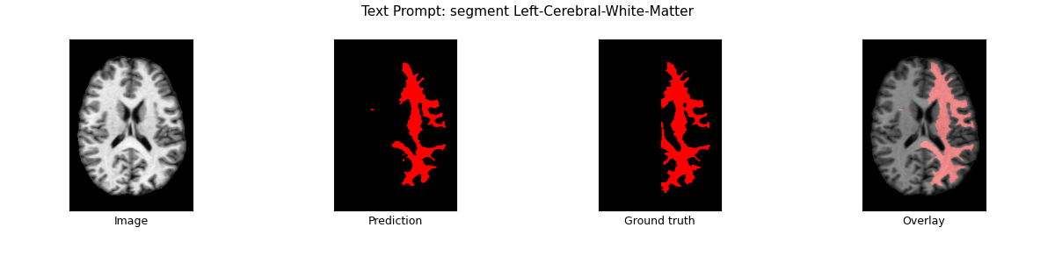
Claim and Target Task
Traditional text guided video segmentation models are only well suited for rigid object segmentation
Training and inference is computational time is very slow for 128 x 128 x 128 voxels
Target Task: Text guided volumetric image segmentation with low training time and inference speed
Notes:
Here, we make the claim of this project.

Slide 9
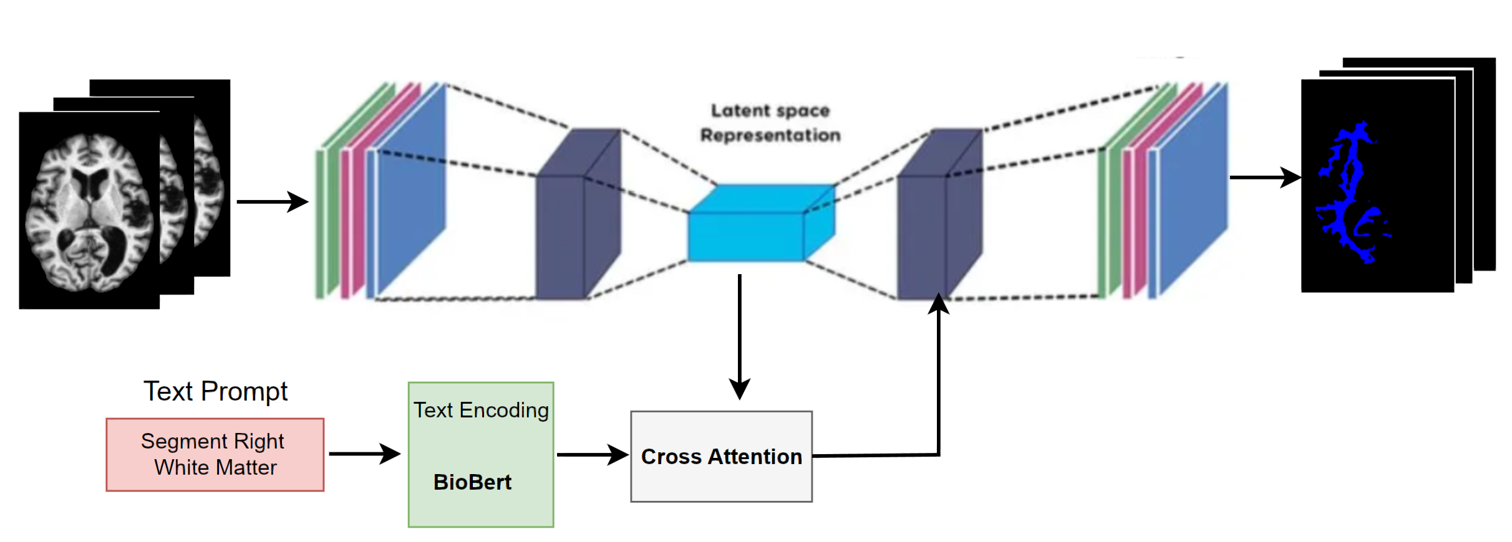
Proposed Solution
Frozen Encoder
Learnable Decoder
Only train the decoder and the cross attention layer
Utilize any pretrain encoder, e.g., UNet, SwinTransformer, SAMv2, SAMv1
Lower Inference time
Notes:
Here is our proposed solution.

Slide 10
Implementation
Pretrained image Encoder: ImageNet UNet
Text encoder: BioBERT
Batch size: 2
Voxel size: 160 x 40 x 224
Learning rate: 1e-5
Weight decay: 1e-5
Early stopping patience: 3
GPU: NVIDIA A40 40 GB (20GB used)
Notes:
In the rest of this presentation, I’m going to talk about following contents:

Slide 11
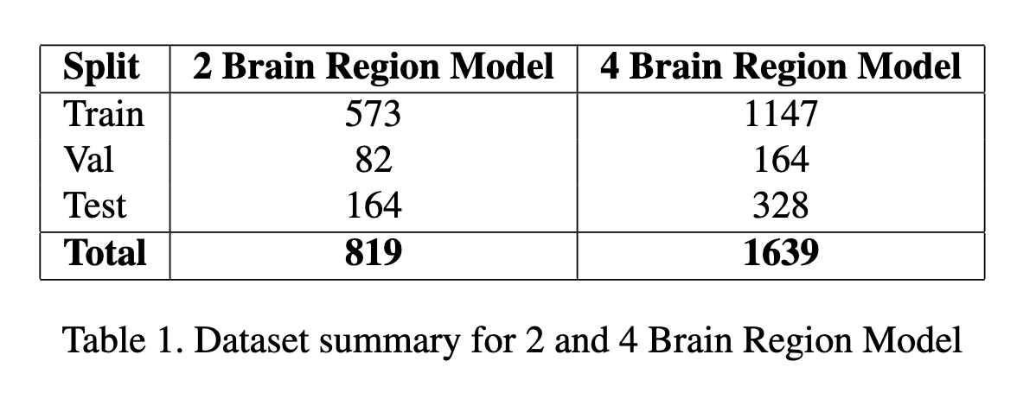
Data Summary
OASIS-v1 dataset
Triplets – (Brain voxel video, Ground Truth Segmentation label, text prompt)
Notes:
In the rest of this presentation, I’m going to talk about following contents:

Slide 12
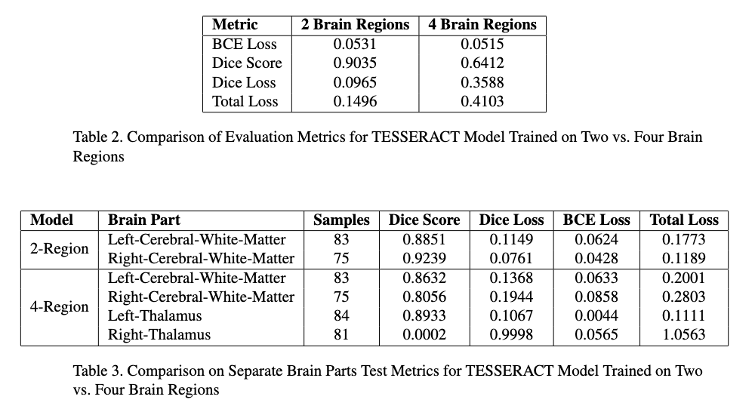
Experimental Results
Notes:
In the rest of this presentation, I’m going to talk about following contents:

Slide 13
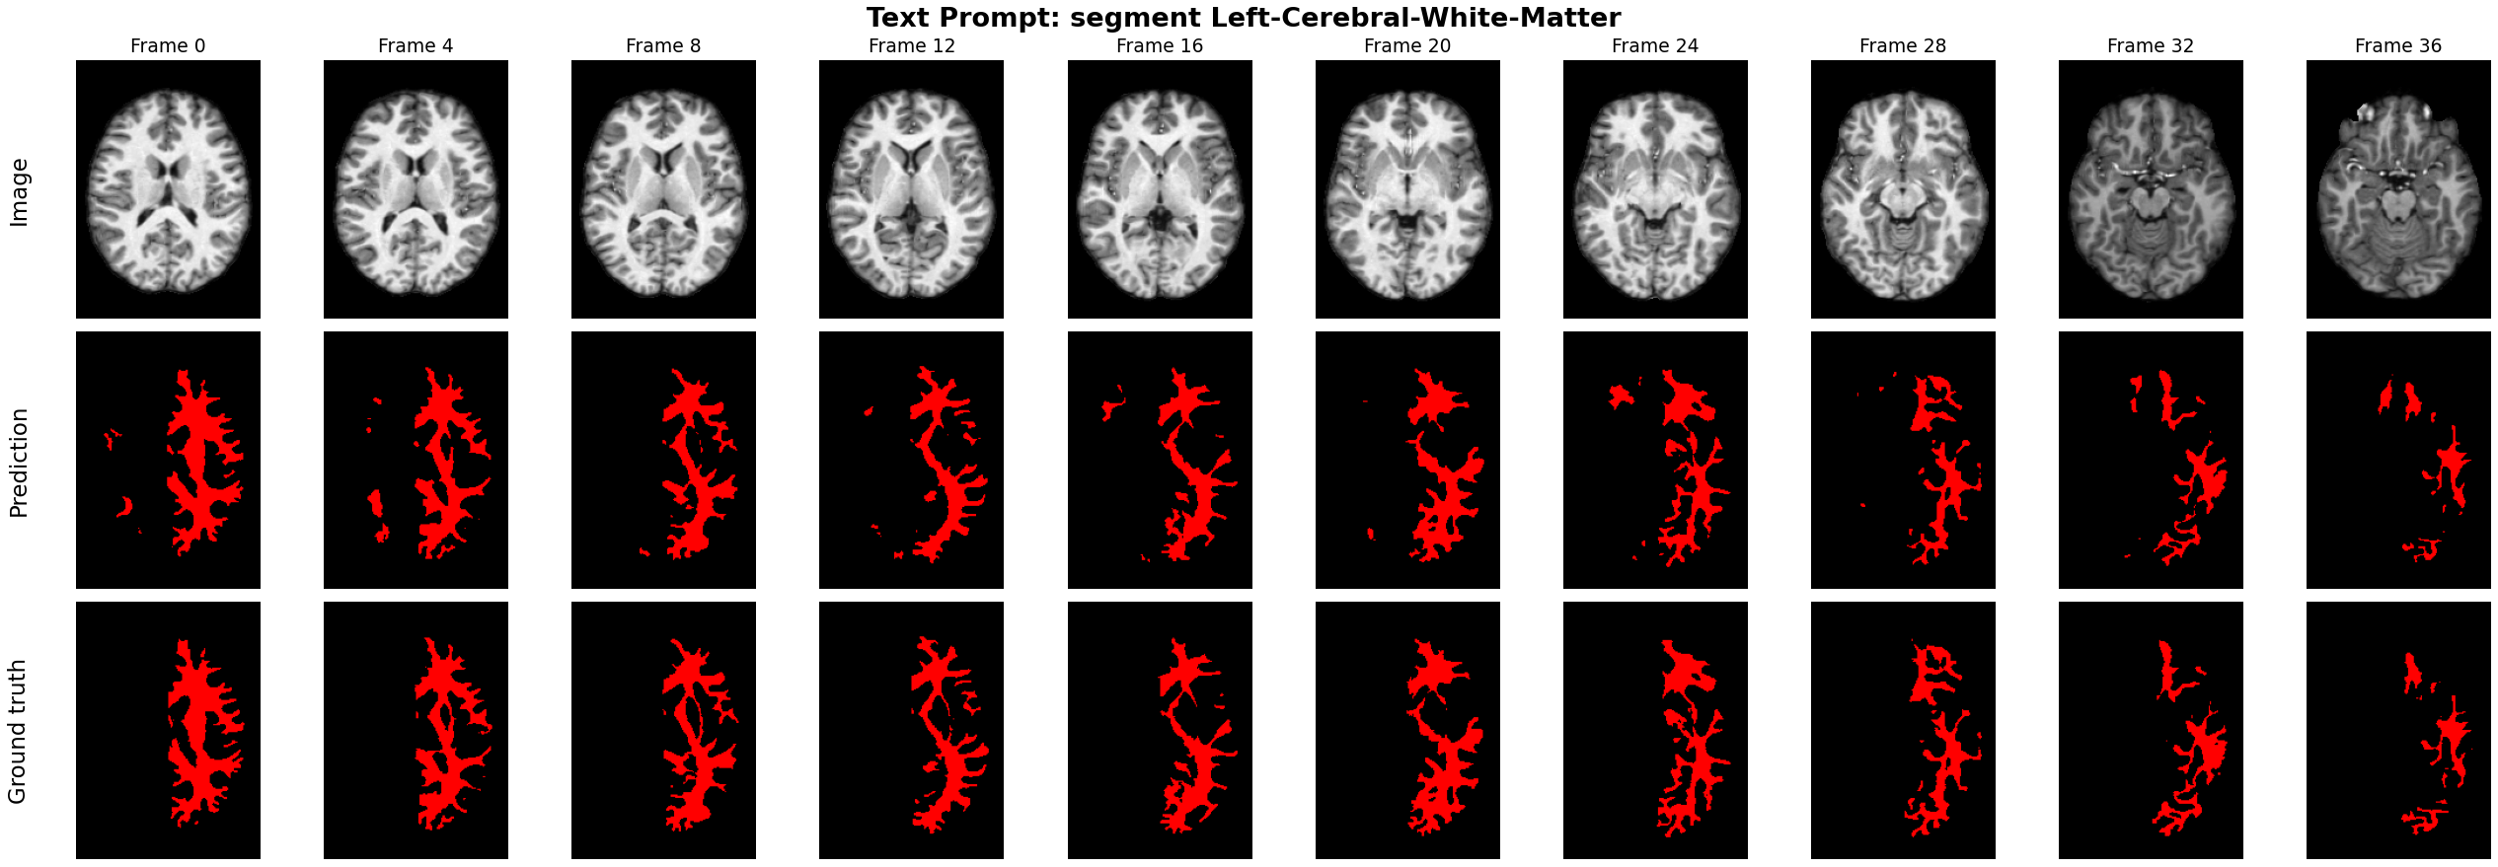
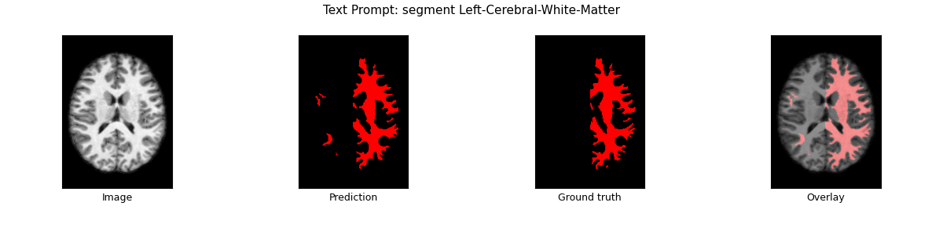
Experimental Analysis
2 Brain region segmentation model performance
Notes:
In the rest of this presentation, I’m going to talk about following contents:

Slide 14
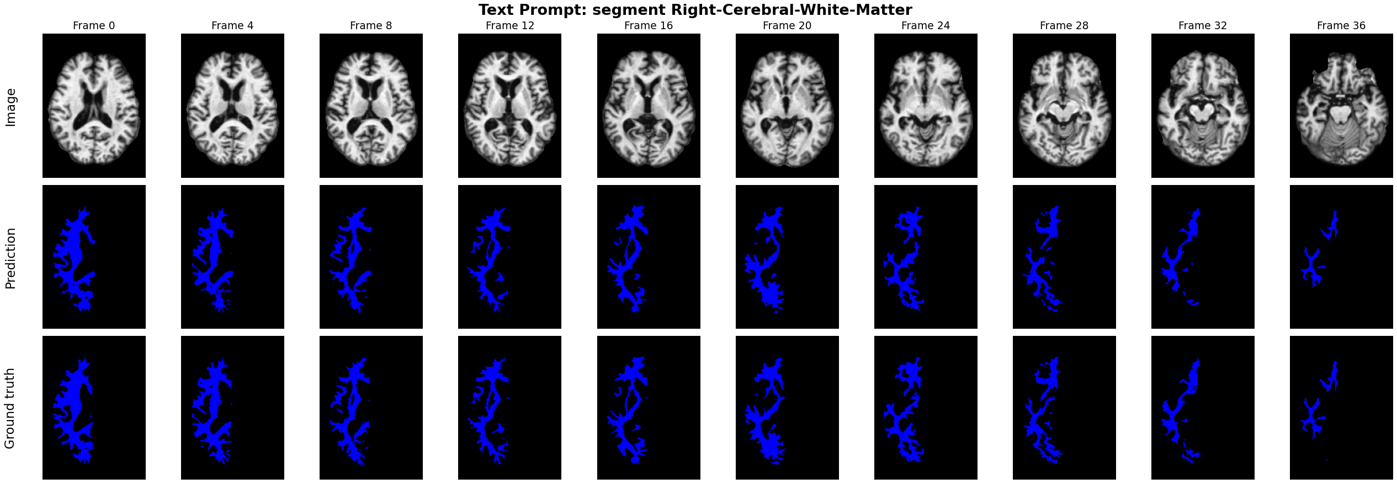
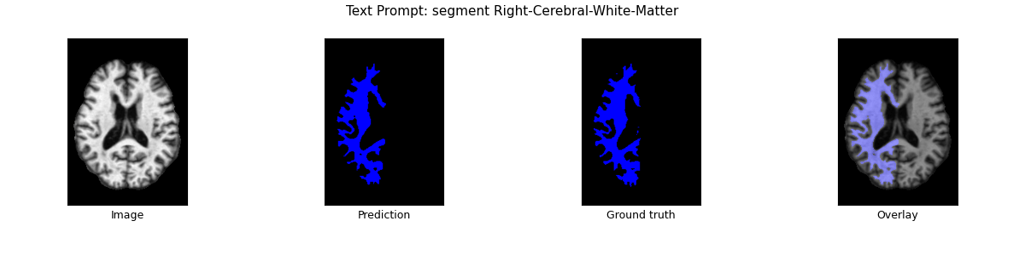
Experimental Analysis
2 Brain region segmentation model performance
Notes:
In the rest of this presentation, I’m going to talk about following contents:

Slide 15
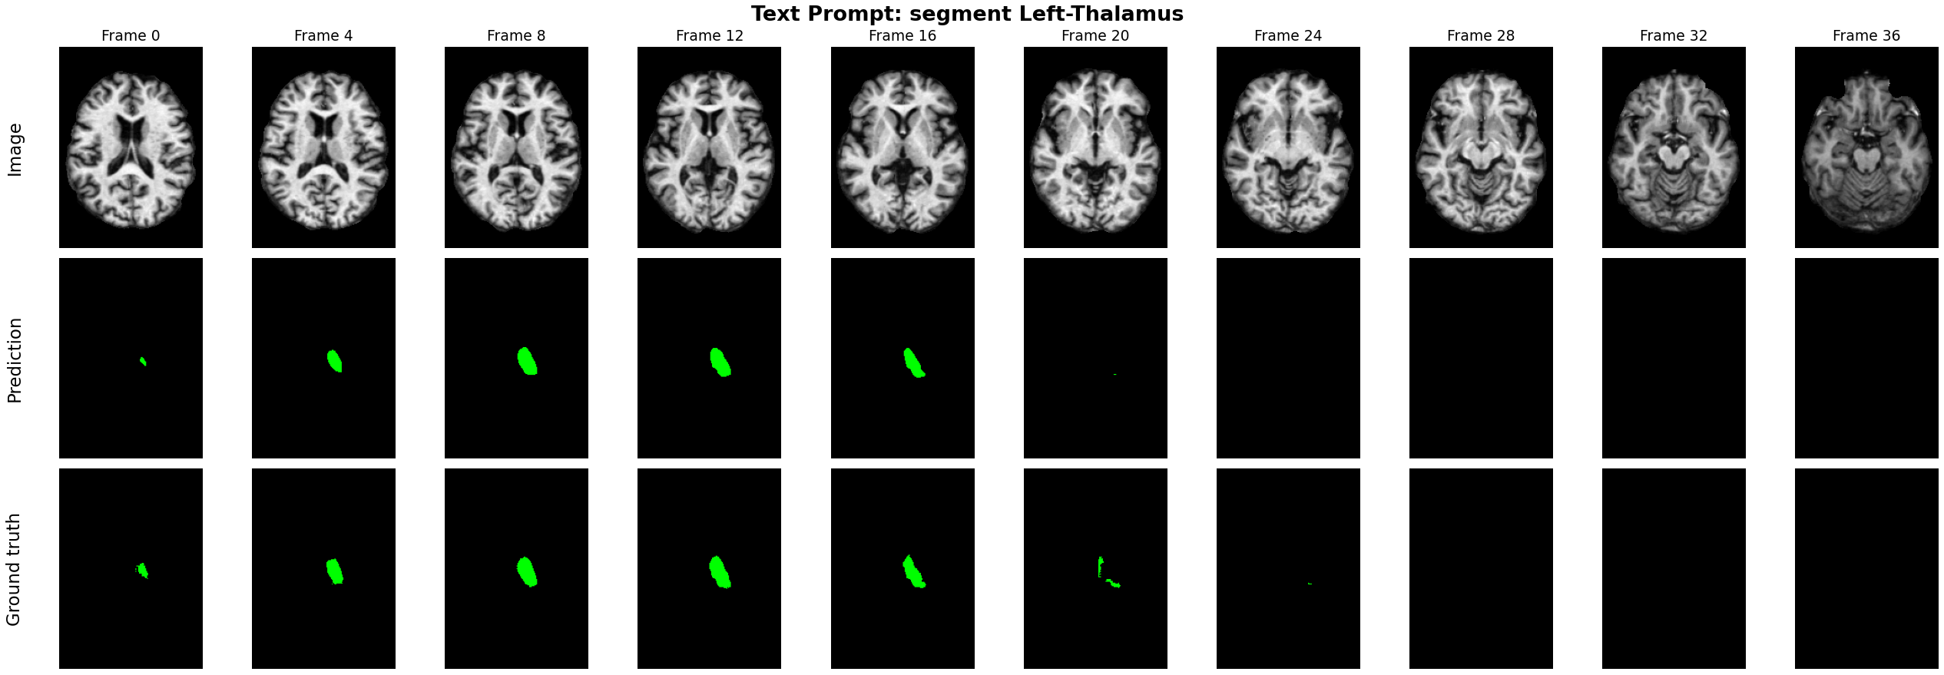
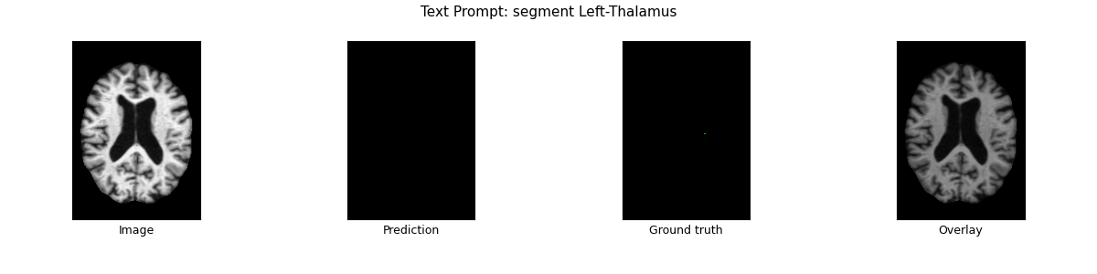
Experimental Analysis
4 Brain region segmentation model performance
Notes:
In the rest of this presentation, I’m going to talk about following contents:

Slide 16
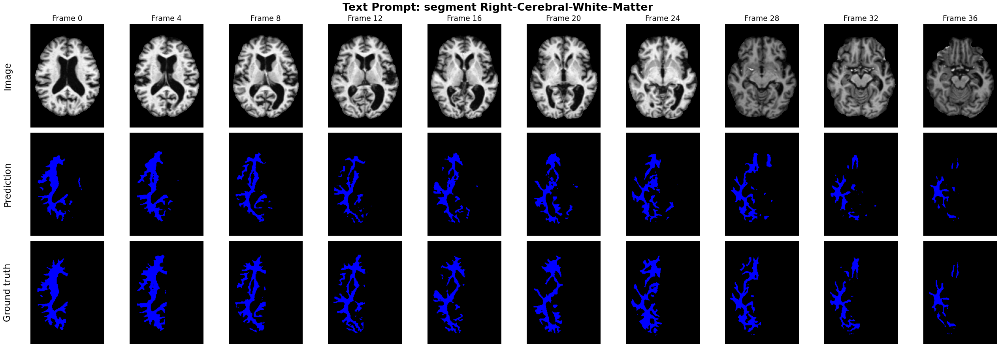
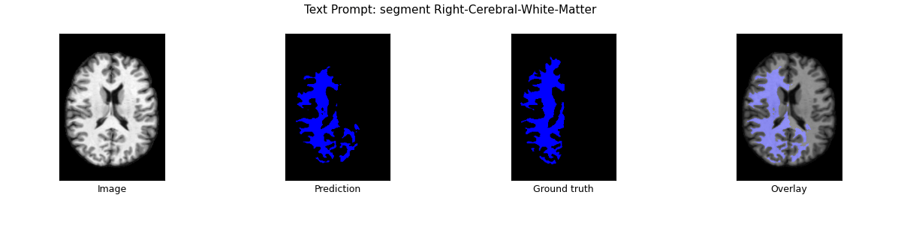
Experimental Analysis
4 Brain region segmentation model performance
Notes:
In the rest of this presentation, I’m going to talk about following contents:

Slide 17
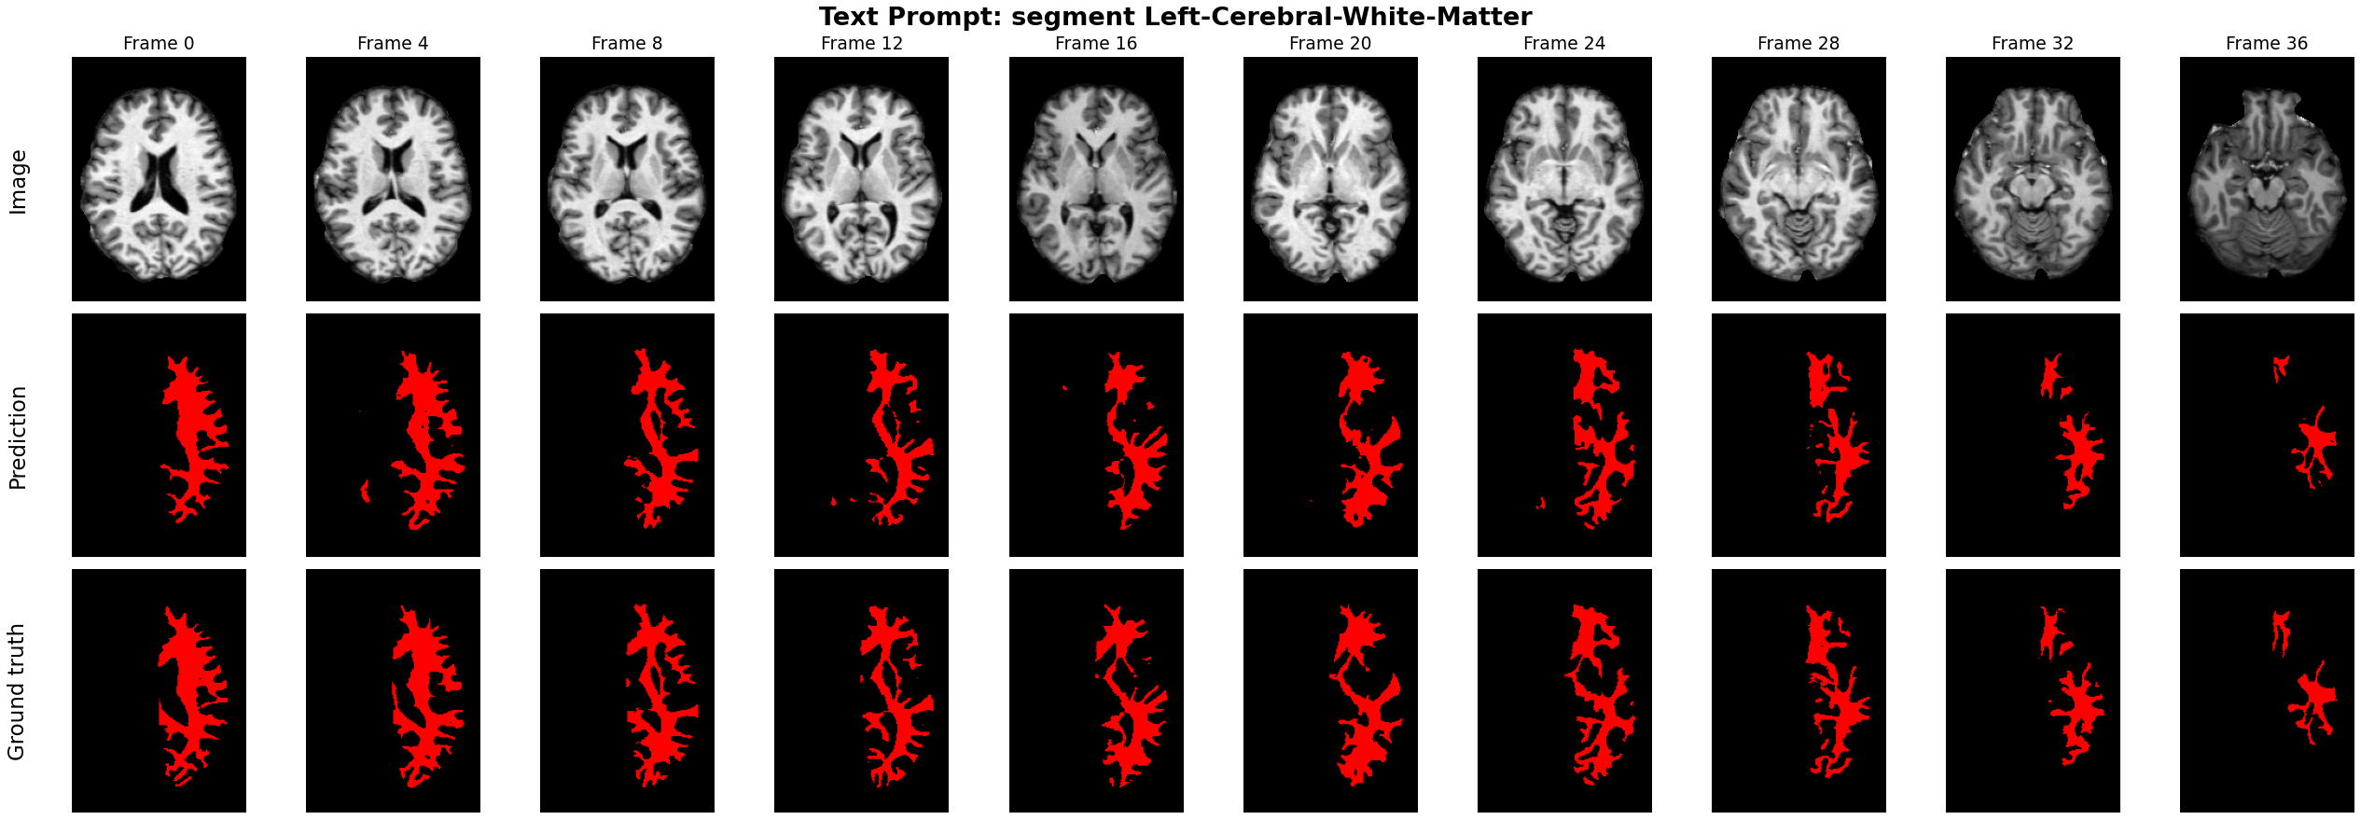
Experimental Analysis
4 Brain region segmentation model performance
Notes:
In the rest of this presentation, I’m going to talk about following contents:

Slide 18
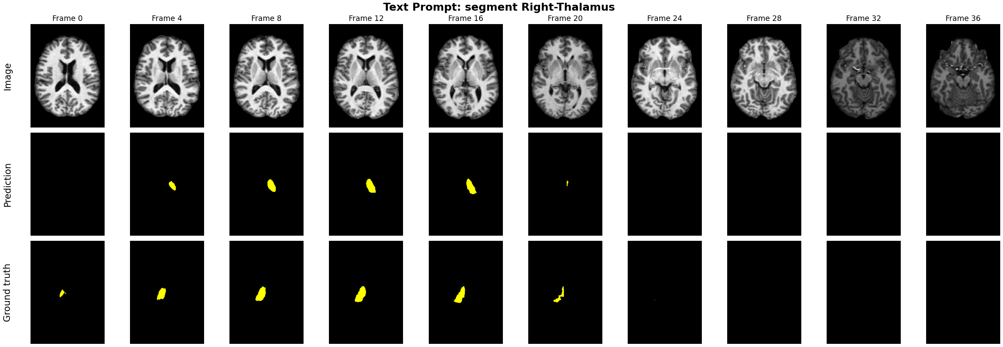
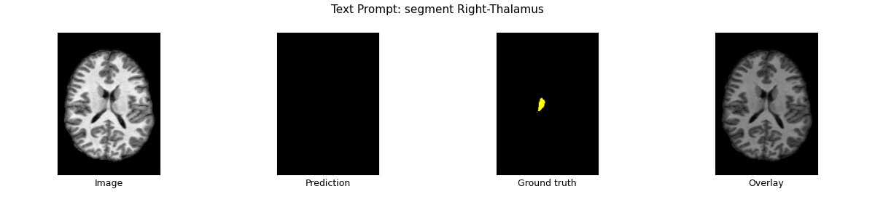
Experimental Analysis
4 Brain region segmentation model performance
Notes:
In the rest of this presentation, I’m going to talk about following contents:

Slide 19
Conclusion and Future Work
Proposed easy to train text guided brain segmentation model
Lower inference time compared to video diffusion model
Further work needed to align the text embedding with the learned feature vector
Increasing the anatomical structures in the voxel to segment
Multiple region segmentation at the same time with text prompt

Slide 20
References
Claudia Cuttano, Gabriele Trivigno, Gabriele Rosi, Carlo Masone, and Giuseppe Averta. Samwise: Infusing wisdomin sam2 for text-driven video segmentation. arXiv preprint arXiv:2411.17646, 2024
Young Woon Kim, Hyunjun Cho, Sung-Jea Ko, and Seung-Won Jung. Text knowledge-guided segment anythingmodel for medical image segmentation. In 2024 International Technical Conference on Circuits/Systems, Computers,and Communications (ITC-CSCC), pages 1–4. IEEE, 2024
Jia Deng, Wei Dong, Richard Socher, Li-Jia Li, Kai Li, and Li Fei-Fei. Imagenet: A large-scale hierarchical imagedatabase. In 2009 IEEE Conference on Computer Vision and Pattern Recognition, pages 248–255, 2009.
https://sites.wustl.edu/oasisbrains/home/oasis-1/

